Slide 1
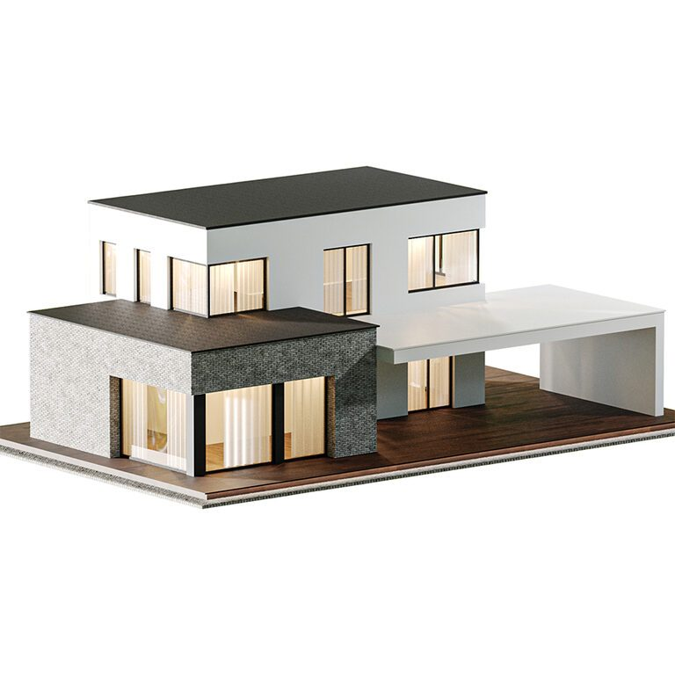
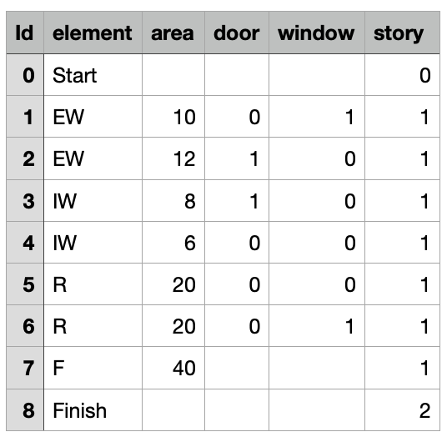

Slide 2
Element | Recipe
Exterior wall | EW_POS + EW_AOS
Interior wall | IW_POS + IW_AOS
Floor | F_POS + F_AOS
Roof | R_POS + R_AOS
Task | Labor | Machine | Duration
EW_POS | 2 | 1 | 1
EW_AOS | 3 | 1 | 2
IW_POS | 2 | 1 | 1
IW_AOS | 3 | 1 | 2
F_POS | 3 | 1 | 1
F_AOS | 4 | 1 | 3
R_POS | 4 | 1 | 1
R_AOS | 4 | 1 | 4
 | Constraints
Relationship on the same level | F → IW → EW → R
Relationship on the different level | EW → F
Sequential task per element | POS → AOS

Slide 3
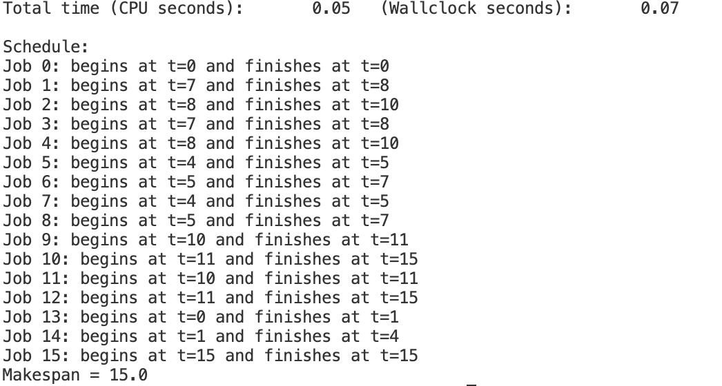
5
6
1
2
9
10
13
13
14
15
7
8
3
4
11
12

Slide 4
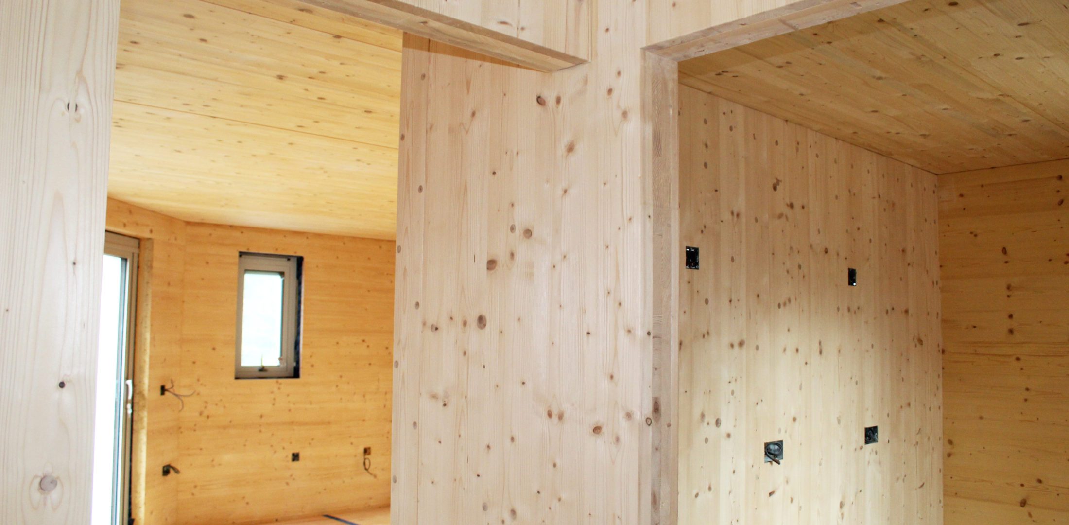
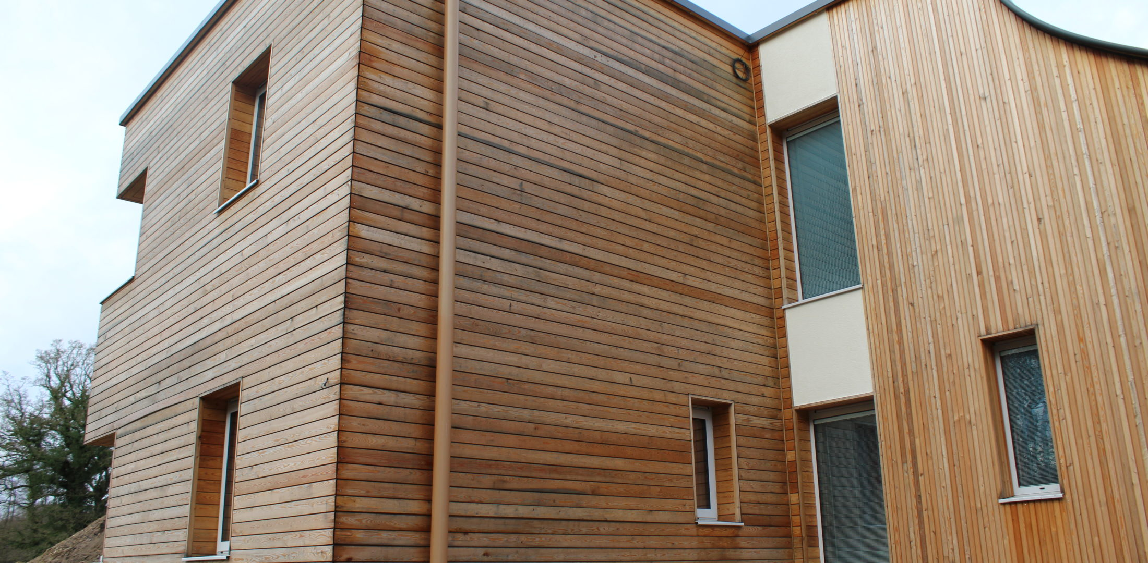
Interior wall (IW / IWB)
Machining
Unloading
Screwing
Exterior wall (EW)
Machining
Cladding
Unloading
Screwing

Slide 5
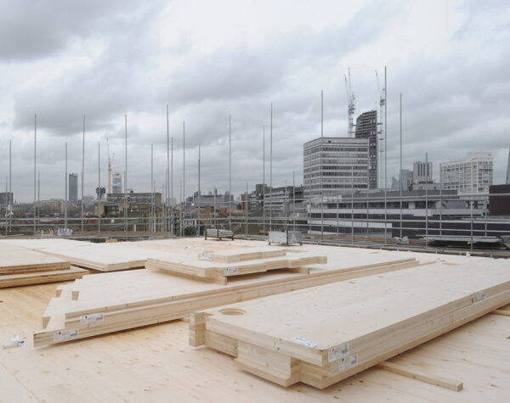
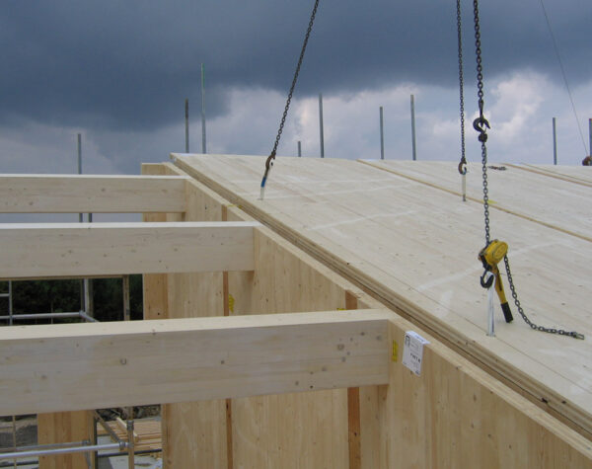
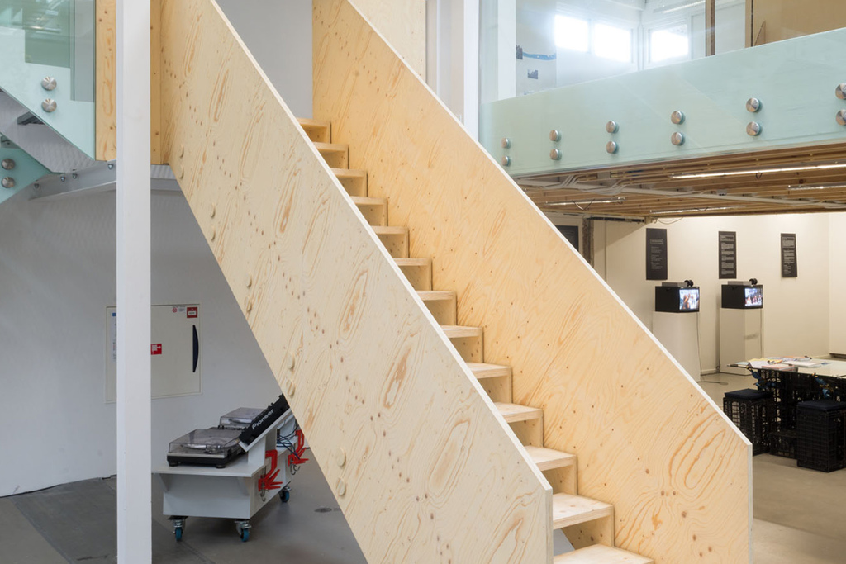
Floor (F)
Machining
Unloading
Screwing
Roof (R)
Machining
Unloading
Screwing
Stair (S)
Machining
Assembly
Unloading
Screwing
https://ecohousemart.com/technology/clt-construction-process/

Slide 6
 | type | storey | length | width | area | doors | windows
0 | Start | 0 | -1 | -1 | 5.45243221 | 0 | 0
1 | F | 0 | 9.8821435 | 10.2889689 | 101.677067 | 0 | 0
2 | EW | 0 | 9.8821435 | 3 | 29.6464305 | 0 | 3
3 | EW | 0 | 9.8821435 | 3 | 29.6464305 | 0 | 2
4 | R | 1 | 8.97004938 | 6.87854337 | 61.7008737 | 0 | 0
5 | IW | 0 | 8.97004938 | 6.87854337 | 61.7008737 | 0 | 0
6 | IW | 0 | 2.74814548 | 3 | 8.24443645 | 1 | 0
7 | IW | 0 | 2.74814548 | 3 | 8.24443645 | 1 | 0
8 | S | 0 | 2.74814548 | 3 | 8.24443645 | 1 | 0
9 | Finish | 1
Element | Recipe
EW | 1,4,2,3
IW | 1,2,3
F | 1,2,3
R | 1,2,3
S | 1,5,2,3
task | duration (/h) | notes
1 | 3 | machining
2 | 1 | unloading
3 | 1 | screwing
4 | 2 | cladding
5 | 3 | assembly
Task | Labor | Bridge | Crane | Cladding
1 | 2 | 1 | 0 | 0
2 | 3 | 0 | 1 | 0
3 | 2 | 0 | 0 | 0
4 | 1 | 1 | 0 | 1
5 | 2 | 1 | 1 | 0

Slide 7
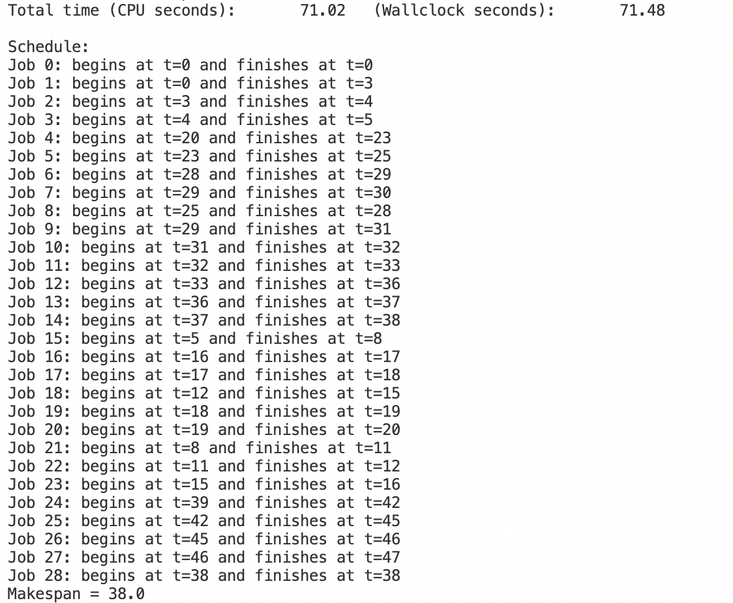
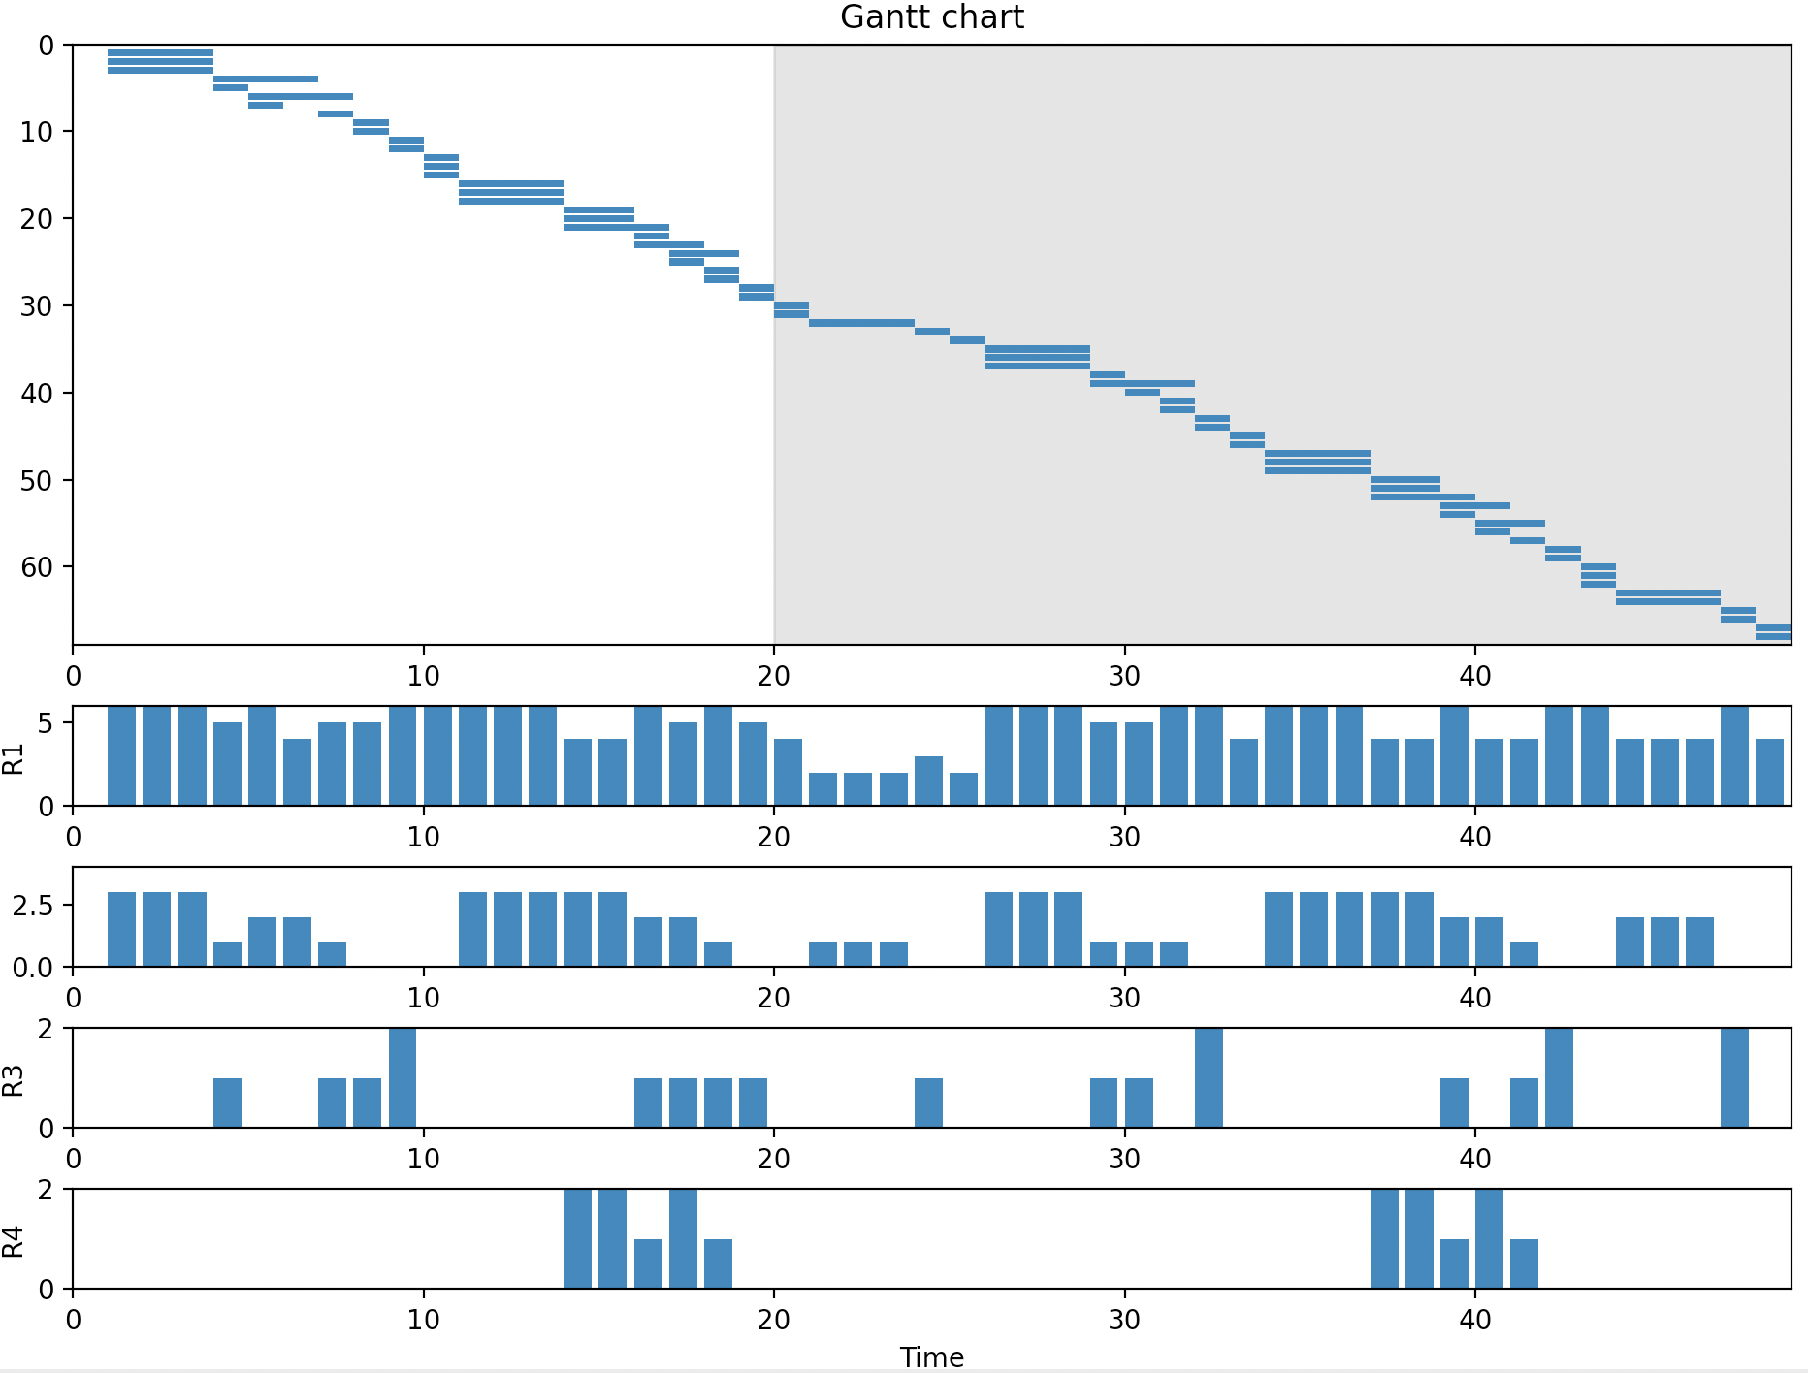

Slide 8
 | type | storey | length | width | area | doors | windows
0 | Start | 0 | -1 | -1 | 5.45243221 | 0 | 0
1 | F | 0 | 9.8821435 | 10.2889689 | 101.677067 | 0 | 0
2 | EW | 0 | 9.8821435 | 3 | 29.6464305 | 0 | 3
3 | EW | 0 | 9.8821435 | 3 | 29.6464305 | 0 | 2
4 | R | 1 | 8.97004938 | 6.87854337 | 61.7008737 | 0 | 0
5 | IW | 0 | 8.97004938 | 6.87854337 | 61.7008737 | 0 | 0
6 | IW | 0 | 2.74814548 | 3 | 8.24443645 | 1 | 0
7 | IW | 0 | 2.74814548 | 3 | 8.24443645 | 1 | 0
8 | S | 0 | 2.74814548 | 3 | 8.24443645 | 1 | 0
9 | Finish | 1
What elements should be taken into accout? Including different types of slabs, and kitchen modules? Including structural elements, MEP elements?
task | duration (/h) | notes
1 | 3 | machining
2 | 1 | unloading
3 | 1 | screwing
4 | 2 | cladding
5 | 3 | assembly
What level of activities should be taken into accout?
Different connection activities
Task | Labor | Bridge | Crane | Cladding
1 | 2 | 1 | 0 | 0
2 | 3 | 0 | 1 | 0
3 | 2 | 0 | 0 | 0
4 | 1 | 1 | 0 | 1
5 | 2 | 1 | 1 | 0
What types of resources should be taken into accout?
Different types of labors
machines for different slab types
cranes for different weight of slabs

